Slide 1
Recommendations for the Five Sessions for Teams and/or Parish Communities
Forming Missionary Disciples!

Slide 2
Logistics of Small Groups for V Encuentro
5 Sessions – weekly, biweekly, other
Easter Season Complete first half of 2017
Form groups now. What groups already exist? How will you invite? Sign ups? Locations?
All Catholics of all backgrounds are encouraged and welcomed to be part of the V Encuentro process…parishes, movements, SCCs, schools, campus ministry, organizations…
Notes:
Logistics of Small Groups for V Encuentro
Parish Encuentro Team oversees the groups/Facilitators
Form groups now. What groups already exist? How will you invite? Sign ups? Locations?
All Catholics of all backgrounds are encouraged and welcomed to be part of the V Encuentro process…parishes, movements, SCCs, schools, campus ministry, organizations…
Children in groups if they can follow the conversation and participate – Adaptations? Please share…
5 Sessions – weekly, biweekly, other
Lent? Easter? Complete first half of 2017
7-12 members per group is ideal
Meet in homes, parish grounds, schools, prisons, offices, funeral homes, parks, community rooms, hospitals…
90 minutes per session
Music found at www.vencuentro.org

Slide 3
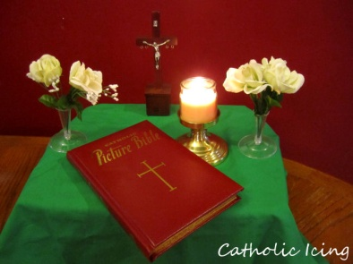
Responsibilities of Small Group Facilitators
Prepare the space for the group to meet.
Guide the conversation, ensuring that everyone is welcomed and has a chance to participate.
Procure and distribute the symbols and any other materials to be used for each of the sessions.
Keep records of who participated in the sessions, respecting privacy and confidentiality.
Submit a report to the Parish Encuentro Team (or coordinating team) at the end of the five session experience.
Notes:
Prepare the space for the group to meet. Facilitators will make sure that there are enough chairs for all participants. All groups should ideally have a small altar or table with a Bible and a crucifix and, ideally, one or two other religious symbols that are meaningful to the members of the group. Be sure all people and pets are taken care of as well as other devices/obstacles that may cause distractions/interruptions. Pens available for jotting down notes and activities. Water at least for participants. Access to restrooms.
Guide the conversation, ensuring that everyone is welcomed and has a chance to participate.
Procure and distribute the symbols and any other materials to be used for each of the sessions.
Keep records of who participated in the sessions. The info will be used as part of the consultation process and shared with the bishops.
Submit a report to the Parish Encuentro Team (or coordinating team) at the end of the five session experience. Will soon be available for download at www.vencuentro.org

Slide 4
Facilitating a Small Group Conversation (Dialogue)
Create an inclusive environment
Invite participants to introduce themselves.
Share expectations for effective dialogue. .
Allow for the sharing of alternate views.
Treat participants with respect and consideration
.
Be aware of barriers to sharing (cultural, social, experiential, etc.)
Invite and encourage all participants to share at least once before inviting participants to share again.
Notes:
Effective facilitation of a dialogue involves the recognition and employment of different perspectives and various skills to create an inclusive environment. In order to do so, it is important to consider the features of effective dialogues, and conditions that promote small group interaction and engagement. Dialogue is a powerful mechanism for active learning; a well-facilitated dialogue allows the participant to explore new ideas while recognizing and valuing the contributions of others.
Create an inclusive environment
Invite participants to introduce themselves
Share expectations and intentions among the participants and the facilitator for effective dialogue.
Invite everyone to express their opinions and thoughts, avoiding situations where one or a few monopolize the conversation.
Treat participants with respect and consideration.
Be aware of barriers to sharing (cultural, social, experiential, etc.)
Invite and encourage all participants to share at least once before inviting participants to share again.
Allow for the sharing of alternate views.

Slide 5
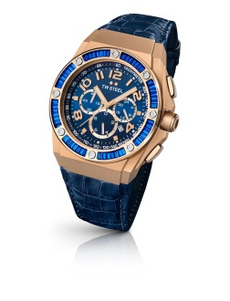
Facilitating a Small Group Conversation (Dialogue)
Keep discussions constructive and positive
Stay centered on the topic.
Follow the process indicated for each session.
Request respect if participants challenge others’ ideas.
Encourage others to add their reactions or ideas to build on previous comments.
Revisit past contributions and incorporate them into subsequent discussions.
Notes:
Keep discussions constructive and positive
Keep the group centered on the topic.
Follow the process indicated for each session, keeping a close watch on time with the assistance of a timekeeper. Once time is up, transition the group into the next section.
Keep the group on task without rushing them.
If the group starts to veer in the direction of negativity and/or pointless venting, ask them how thy would like to address this.
Request that if participants challenge others’ ideas, they do so with respect.
Ask dominant participants to allow others to speak. Did everyone get a chance to speak before I do again?

Slide 6
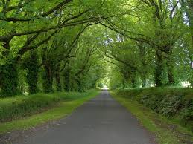
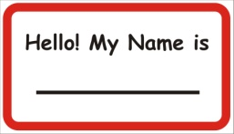
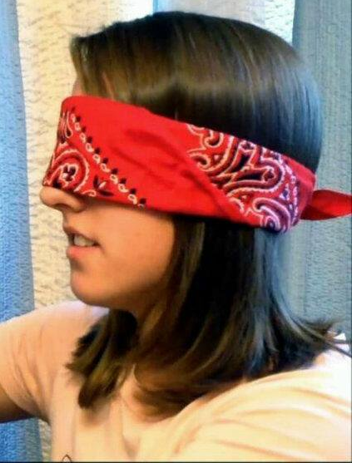
Session 1: Called to a Loving Encounter with Jesus in the Church
Symbols and Supplies:
Image of a Path in center
Blindfolds (one for each participant)
Basket with Wristbands (one per person)
Music and player/speakers (Resources/Music) www.vencuentro.org/v-encuentro-documents/music/
Notes:
Session 1: Called to a Loving Encounter with Jesus in the Church
Symbols and Supplies:
Nametags
Chairs in a circle
Image of a Path in center
Blindfolds (one for each participant)
Music and player/speakers (Resources/Music) www.vencuentro.org/v-encuentro-documents/music/
Prayer (Celebrate)
Blindfolds
Small pieces of paper and pens
Prayer on page 14 (Saint Teresa of Avila)
Music and player/speakers
V Encuentro Mission and Consultation Journal

Slide 7
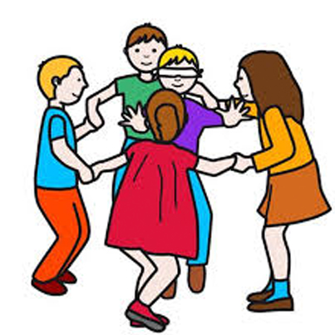
FIRST SESSION START with Prayer
Song Reading: pg. 11, On the Way to Emmaus
Pg. 16, create a ritual with the blindfolds for the prayer and continue with the Reading. With Sending Song give two wristbands two each person, one for the person they will encounter.
Use the SEE, JUDGE, ACT AND CELEBRATE method. See the plan

Slide 8
Plan for the First Session
THEMEI. Called to a loving encounter with Jesus in the Church | PROCESS To venture to go out evangelizing without words | METHOD To See: Identifying the bonds ... The initiative of Jesus to approach is personal and communal To Think: How Jesus makes himself present: past - present To act: to evangelize without words Celebrate: the way Page 16 Going out: Identify fields. Start with observation and start the consultation | MISSION Observe our social environments. Enter any of the fields or environments. Pray to discern where and with whom. Choose someone. | CONSULTATION As a Catholic what brings you happiness? What are your fears and worries? Inside or outside the Church What actions show you that you parish is evangelizing without words? Which Catholic traditions and celebrations do you value the most?

Slide 9
To evangelize without words Observe the most viral gestures of Pope Francis
How he looks to, and listens to others
How he encounters the one who is different from himself
Numerous people around the world have been impacted by his “non verbal language”
TAKE THE FIRST STEP! Go forth, Be the first one to announce the Gospel without words. May your relatives, and those around you deduce: This is how Jesus served, how he gazed and smiled, how he was. Find someone who has
Gone away from our faith, who
Either felt rejected or became
indifferent… evangelize him or her
with your attitude

Slide 10
Practice with the questions from the Diocesan Mission & Consultation Manual 15 minutes
As a Catholic what brings you happiness?
Your short response & what to respond to the other person
2. What are your fears and worries? Inside or outside the Church
Your short response & what to respond to the other person

Slide 11
PRACTICE
3. What actions show you that you parish is evangelizing without words? Your short response & what to respond to the other person
4. Which Catholic traditions and celebrations do you value the most?
Your short response & what to respond to the other person
he Church

Slide 12
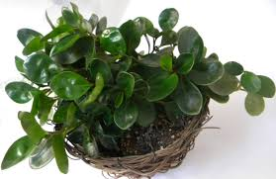
Session 2: With Words and Actions: Do It!
Symbols and Supplies
Image of a Path (Way to Emmaus)
Fount and bottles of Holy Water for each participant
Basket with Mission and Consultation Journals)
Music and player/speakers
Green plant with abundant leaves
Notes:
Session 2: With Words and Actions: Do It!
Symbols and Supplies
Nametags (if there are people not known to all)
Chairs in a circle
Image of a Path
Bottles of Water (for each participant)
Prayer (Celebrate)
Clear bowl with water
Green plant with leaves
Containers (jars/bottles) that workers or immigrants use for water
Soft music sounds of water flowing
Basket with Pocket Books of Four Gospels (2 for each participant)
Music and player/speakers

Slide 13
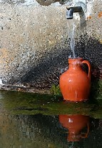
SECOND SESSION Start with the Prayer
Song: Pescador de hombres
Reading : Guide: pg. 19 Lc. 24, 17 -20
and reflection.
Continue with the Plan for the 2nd.Session
Continue with the practice with the questions from the Diocesan Journal
At the end(Celebrate, Guide pg. 24) pray and blessed each other with the water .
With the ending song each person receives a
bottle of Blessed Water.

Slide 14
Plan for the Second Session
II. With wodks and actions: Do it! | To face the difficulties and trials as Catholics in the USA, and to encourage the need for an outgoing church. | To See: Identify the current challenges (personal and of the community) Jesus gets involved, me too, but you have to know how to listen To think: A Friend reaches out in the difficult moments. Our people have experienced this and our faith has been the source of strength. To Act: Getting involved without fear, with determination, trusting God ... To Celebrate: Lord, give us your water Going out: daring to overcome barriers and challenges | Approach the person with genuine interest. Start a respectful dialogue. Express interest in understanding their environment. Inviting the person to identify a periphery and reflect on the struggles that exist there. | 1. Describe 3 unmet expectations of Hispanic people in the US 2. What does the parish do that expresses genuine interest in the struggles people face? How do Catholics find strength to overcome their struggles? 3 Identify outreach ministries that offer accompaniment. If none, what ministries of accompaniment would you like to see? 4. Identify 3 hopes of Hispanics from different generation or ages

Slide 15
Practice with the questions from the Diocesan Mission & Consultation Manual 15 minutes
1. Describe 3 unmet expectations of Hispanic people in the USA
Your short response & what to respond to the other person
2. What does the parish do that expresses genuine interest in the struggles people face? How do Catholics find strength to overcome their struggles?
Your short response & what to respond to the other person

Slide 16
Practice with the questions from the Diocesan Mission & Consultation Manual 15 minutes
3. Identify outreach ministries that offer accompaniment. If none, what ministries of accompaniment would you like to see? Your short response & what to respond to the other person
4. Identify 3 hopes of Hispanics from different generation or ages
Your short response & what to respond to the other person

Slide 17
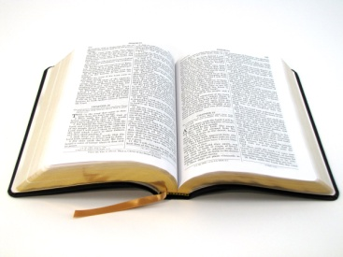
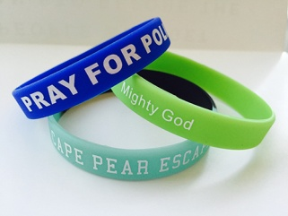
Session 3: Walking Together with Jesus
Symbols and Supplies
Image of the Path in the center with Jesus and two people
On a table
Bible
Basket with V Encuentro Wristbands (1 for each participant )
Music and player/speaker
Prayer (Celebrate)
Notes:
Session 3: Walking Together with Jesus
Symbols and Supplies
Chairs in a circle
Image of the Path in the center
On a table
Bible
Basket with V Encuentro Wristbands (2 for each participant)
Music and player/speaker
Prayer (Celebrate)
Lit candles
Flowers
Incense
Table with Bible and wristbands
Music and player/speaker

Slide 18
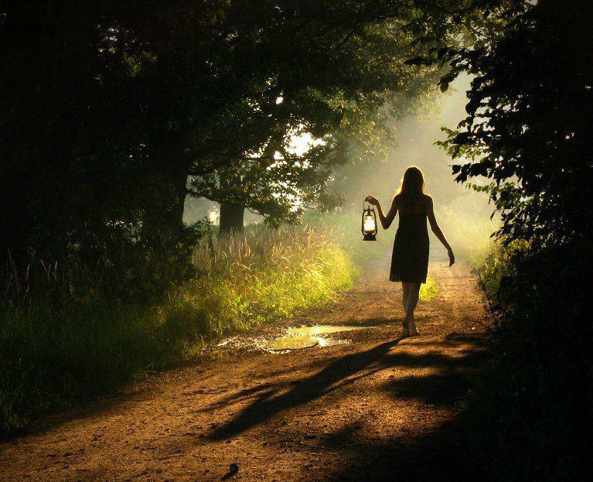
TERCERA SESION comenzar con la Oración Compartida
Canto: Un Pueblo que Camina
Lectura : Guía: pg.27 Lc. 24, 25 -29
y reflexión.
Siguen con el Plan para la 3ra. Sesión
Siguen con la practica con las preguntas del Diario diocesano de
misión y consulta.
Al terminar (Celebrar, Guía pg. 32)proceden en procesión alrededor del salón siguiendo a personas que llevan la Biblia y una vela grande. Después de la siguiente oración, con el Canto “Salgamos a llevar el Evangelio” todos besan o veneran la Palabra de Dios, y reciben un brazalete.

Slide 19
Plan for Session 3
III. Walking Together with Jesus | To deepen our call to be mission-ary disciples. | To See: Our people participate in the cross, but the risen one invites us to understand its meaning To think: Jesus explains: we must die to live based on the Word. Jesus urges us to understand our life’s purpose. As disciples, the night terrifies us and we want Jesus to stay with us. To Act: Inviting Jesus personally and in community To Celebrate: Ritual pages 31-32 | Maintain relationship with the person with various gestures. Intentionally seek for a moment to express something about the Word of God. | 1. What role does Scripture play in your life and that of your family? Give examples 2. What opportunities does your parish offer for your continual encounter with Jesus? 3. In what ways has your parish called you to be a missionary disciple. 4. How have the sacraments impacted your life and the life of your family? Give examples

Slide 20
Practice with the questions from the Diocesan Mission & Consultation Manual 15 minutes
1. What role does Scripture play in your life and that of your family? Give examples Your short response & what to respond to the other person
2. What opportunities does your parish offer for your continual encounter with Jesus? Your short response & what to respond to the other person

Slide 21
Practice with the questions from the Diocesan Mission & Consultation Manual 15 minutes
3. In what ways has your parish called you to be a missionary disciple. Your short response & what to respond to the other person
4. How have the sacraments impacted your life and the life of your family? Give examples Your short response & what to respond to the other person

Slide 22
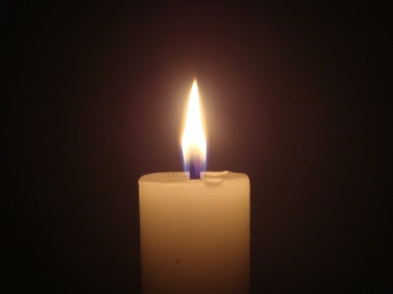
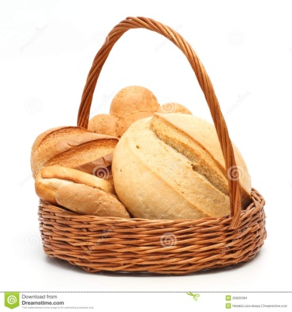
Session 4: Bearing Fruits of New Life
Symbols and Supplies
Image of a path in the center
Candle
Basket with bread (for all to share)
Music and player/speakers
Prayer (Celebrate)
Tea light candles for all participants are optional
Notes:
Session 4: Bearing Fruits of New Life
Symbols and Supplies
Chairs in a circle
Image of a path in the center
Candle
Basket with bread
Music and player/speakers
Prayer (Celebrate)
A candle placed high
Basket with enough bread for all participants
Tea light candles for all participants
Music and player/speakers

Slide 23
FOURTH SESSION to begin with the PRAYER
Song: Our Hearts Burned Within Us
Reading : Guíde: pg.27 Lc. 24, 29 -36
and reflection.
Continue with the Plan for the 4th. Session
Continue with the practice of the questions from the Diocesan Journal of Mission and Consultation
At the end (Celebrate, Guide pg. 40) after sharing the bread and the following prayer, a candle could be passed from hand to hand saying: “I pray that you may be able to bring the Light of Christ to those peripheries you have encountered” and finish with the song “Un Pueblo en Marcha” (or another).

Slide 24
Plan for Session 4
IV. Bear ing fruits of new life | Getting ready for the evangelizing mission and consultation in the peripheries. | To See: take into account how the Hispanic people with what little they have has multiplied blessings like yeast. Despite our limitation, we have flourished. To think: The demanding call to bear abundant fruit. Apply to ourselves the rule that the tree is known by its fruits ... The Eucharist nourishes us for this task. To Act: Align our actions to the merciful action of Christ. To Celebrate: The light does not go out, the bread comforts us Pg. 40 Going out: Walking with the people | Take on an initiative to help in solidarity to a greater reality. Identify potential resources. Let people know about Church organizations. Invite people who are actively involved in the peripheries to give testimony to our groups about how much can be done. | 1 How do you live your baptismal call to be a missionary disciple? 2. In what ways have you responded to Pope Francis’ call to respond to the needs of society in light of our Catholic identity? 3. Name some examples of acts of mercy that you see the parishes offer and have worked well 4. What kind of hospitality does our parish offer? Identify 3 actions that express a welcoming attitude. Is this enough? Is that what people expect?

Slide 25
Practice with the questions from the Diocesan Mission & Consultation Manual 15 minutes
1. How do you live your baptismal call to be a missionary disciple? Your short response & what to respond to the other person
2. In what ways have you responded to Pope Francis’ call to respond to the needs of society in light of our Catholic identity? Your short response & what to respond to the other person

Slide 26
Practice with the questions from the Diocesan Mission & Consultation Manual 15 minutes
3. Name some examples of acts of mercy that you see the parishes offer and have worked well Your short response & what to respond to the other person
4. What kind of hospitality does our parish offer? Identify 3 actions that express a welcoming attitude. Is this enough? Is that what people expect?
Your short response & what to respond to the other person

Slide 27
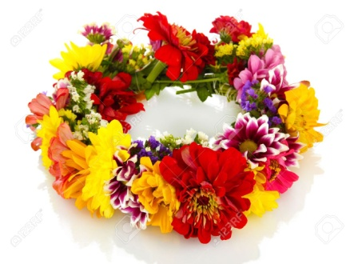
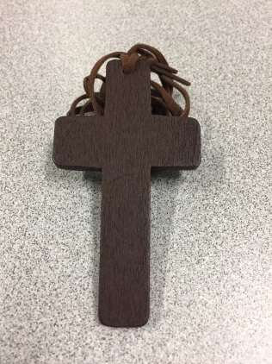
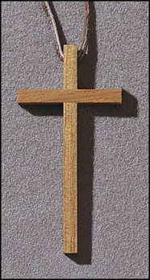
Session 5: Celebrating the Joy of Being Missionary Disciples
Symbols and Supplies
Image of the Path in the center Large Cross
Basket with the V Encuentro Crosses
Candle and Open Bible
Prayer
Side table with wreath of flowers and white cloth
White paper cross and pens
Tape
Notes:
Session 5: Celebrating the Joy of Being Missionary Disciples
Symbols and Supplies
Chairs in a circle
Image of the Path in the center
Basket with the V Encuentro Crosses
Candle and Open Bible
Prayer
Large Cross
Side table with wreath of flowers and white cloth
White paper cross and pens
Tape

Slide 28
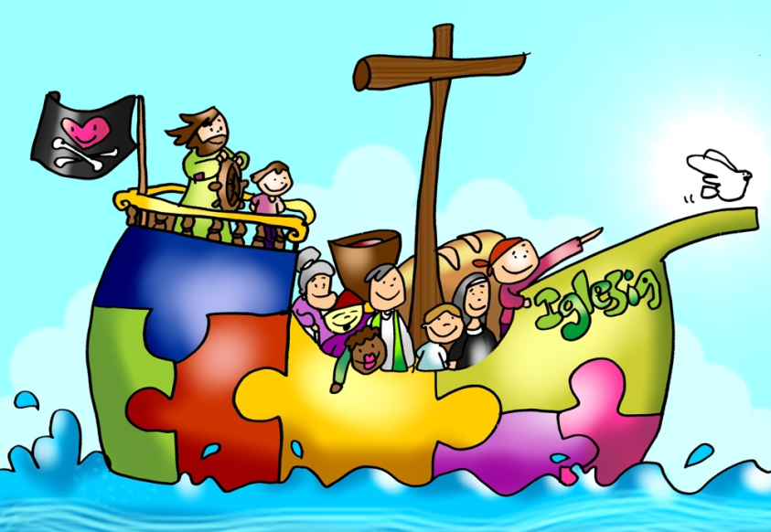
FIFTH SESSION begin with the Prayer
Song: Santa Maria del Camino or other
Reading: Guide pg.43 Lc. 24, 32 -35
and reflection
Continue with the Plan for the 5th. Session
Continue with the practice with the diocesan Journal of Mission and Consultation
At the end(Celebrate, Guide pg. 48) after the following prayer, a cross is given to each one and they are invited to decorate them in celebration (or they can take it home and do it with their children) Ending Song is “Nuestra Alegría” (or one similar).

Slide 29
Plan for Session 5
V. Celebrating the joy of being mission ary disciples | To celebrate and deepen the strength we find in celebrating with gratitude and joy for life. Sum up the experience and the results of the consultation process and determine its pastoral implications. | To See: The Encounter with Christ quenches all fear, returns joy and promptness. Identify the blessings received that have led us to "have a party" about it. To think: The Eucharist is the highest festive expres sion of our communities. Have we found in the Eucharist nourishment and the enthusiasm to go out in mission? There are many fears that we still need to let go to be able to become a community. To Act: Community of missionary disciples in everything we do To Celebrate: With The Cross we will win p.48. Going out: The firm resolution to proclaim the gospel | To continue evangelizing and preparing the parish Encuentro | 1. Share 3 main blessings that people you encountered during this process, recognized in their lives 2. What actions will you take to be an evangelizer, from now on? 3 What insights do you see unveiling in the Encuentro process? 4 Point out 3 celebrations that you think are key to pass on our faith to the new generations.

Slide 30
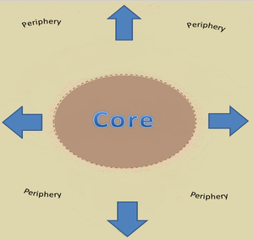
The Periphery?
Places where our sisters and brothers are vulnerable, excluded, treated as outsiders, living in fear, isolated, ignored, invisible.
Pope Francis reminds us that as baptized Christians, Catholics must embrace the call from Jesus Christ “to go forth from our own comfort zone in order to reach all the ‘peripheries’ in need of the light of the Gospel.”
Each community, each family, each person must identify the immediate peripheries and then go and meet people there with a message of love and hope in a spirit of accompaniment.
Many Hispanic Catholics—as well as other Catholics— live in the peripheries of our Church and society.
We are called to bring the light of the Gospel to all these groups.
Notes:
The Periphery?
We invite you to focus as much as possible on Hispanic/Latino young people and families, especially those living in the peripheries of church and society. What is a periphery? Places where our sisters and brothers are vulnerable, excluded, treated as outsiders, living in fear, isolated, ignored, invisible. Many Hispanic/Latino Catholics may not be active in our churches. Others find themselves estranged, feeling that they do not belong to our parish communities. They can be college students, farmworkers, at risk youth, people who are homeless, and those in prison. Many are waiting for someone to share the Good News of the Gospel and that God cares about them. You are God’s eyes, hands, and feet to reach out to them. Carry this journal with you. Treasure it. Discuss it. Bring it to the V Encuentro sessions.
Places where our sisters and brothers are vulnerable, excluded, treated as outsiders, living in fear, isolated, ignored, invisible. The “peripheries” are all those circumstances in which many sisters and brothers are experiencing some form of hardship—material, social, cultural, or spiritual.
Pope Francis reminds us that as baptized Christians, Catholics must embrace the call from Jesus Christ to “to go forth from our own comfort zone in order to reach all the ‘peripheries’ in need of the light of the Gospel.” l.
Not all peripheries are the same. Each community, each family, each person must identify the immediate peripheries and then go and meet people there with a message of love and hope in a spirit of accompaniment.
Many Hispanic Catholics—as well as other Catholics—live in the peripheries of our Church and society: the young people who do not see the Church as their home anymore, the disaffected, the undocumented, the poor, the victims of abuse and prejudice, the farmworker and the factory worker who cannot make ends meet, the elderly, the broken family, the lonely, the addict, the imprisoned, the sick, etc.
To all these groups we are called to bring the light of the Gospel.

Slide 31
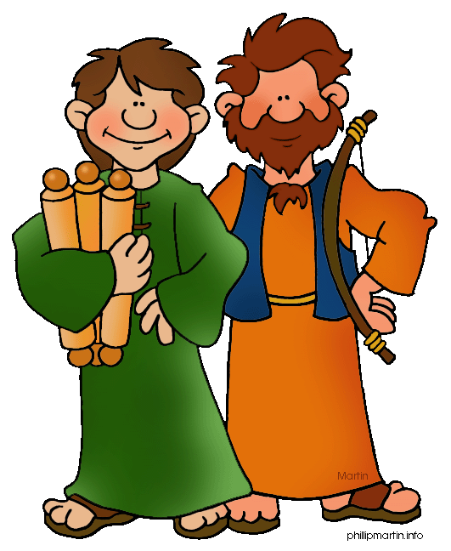
10 Tips for Missionary Activities
Choose your missionary partner. The Lord sent his disciples in pairs (Lk 10:1).
Pray for wisdom before going to visit someone. Pray in thanksgiving after returning.
If you are reaching out to people you know, contact them in advance of the visit.
If you are going to the periphery, engage people in a natural and polite way, showing authentic interest in getting to know them.
Bring some information and bulletin about your parish or faith community to share.
Notes:
TIPS FOR MISSIONARY ACTIVITIES
If you are a baptized Catholic, then you already are a missionary! Yes, our entire lives as Christians are about participating in the Lord’s evangelizing mission. The Church exists to evangelize. As baptized Catholics, the Holy Spirit moves us to announce the Good News and give witness of the great things God has done in our lives through Jesus Christ.
Just by living an authentic Catholic life inspired by the values of the Gospel and faithful to God’s Word, you are doing missionary work. Make sure you continue to do this!
10 Tips
1Choose your missionary partner. The Lord sent his disciples in pairs (Lk 10:1).
Pray for wisdom before going to visit someone. Pray in thanksgiving after returning.
If you are reaching out to people you know, contact them in advance of the visit.
If you are going to the periphery, engage people in a natural and polite way, showing authentic interest in getting to know them.
Bring some information about your parish or faith community to share.

Slide 32
10 Tips for Missionary Activities cont.
Be respectful. Avoid entering into controversies.
Use the questions in the Mission and Consultation Journal. Then, listen... listen attentively and lovingly.
Keep the conversation short.
Write a few notes and respond to questions in the Mission and Consultation Journal after your return.
If you have any questions, consult with the leaders of the V Encuentro team in your parish or faith community.
Notes:
Be respectful. Avoid entering into controversies. If you don’t know the answer to a question, write it down and indicate that you will bring an answer next time.
Use the questions in the Mission and Consultation Journal. Then, listen... listen... listen attentively and lovingly. Ask the following questions while talking with them.
Make sure it does not sound like a survey, but a conversation in which you want to learn about them.
Feel free to change the question so it sounds more like something you would say.
If they do not want to answer or don’t feel comfortable answering, do not push them.
When you are done, thank them for their time and ask if you can stay in touch.
After the conversation, jot down this information in your journal and complete the consultation form.
Keep the conversation short.
Write a few notes and respond to questions in the Mission and Consultation Journal after your return.
If you have any questions, consult with the leaders of the V Encuentro team in your parish or faith community.
Note: Missionaries should not visit or contact minors under the age of 18 without the presence of a parent or adult following Safe Environment Guidelines.

Slide 33
God of Mercy,
You that went out to encounter the disciples on the way to Emmaus,
grant us a missionary spirit and send us forth to encounter our brothers and sisters,
to walk along beside them,
listen to their hopes and dreams,
rekindle their faith with the fire of your Word,
prepare them to recognize you in the Eucharist and send them as missionary disciples
to share the joy of the Gospel to present and future generations
of every race, language and culture.
We ask you this from our burning hearts filled with the Holy Spirit,
in the Name of your beloved Son
and through the intercession of our Mother, Mary of Guadalupe
Star of the New Evangelization
Amen.
Notes:
God of Mercy,
You that went out to encounter the disciples on the way to Emmaus,
grant us a missionary spirit and send us forth to encounter our brothers and sisters,
to walk along beside them,
listen to their hopes and dreams,
rekindle their faith with the fire of your Word,
prepare them to recognize you in the Eucharist and send them as missionary disciples
to share the joy of the Gospel to present and future generations
of every race, language and culture.
We ask you this from our burning hearts filled with the Holy Spirit,
in the Name of your beloved Son
and through the intercession of our Mother, Mary of Guadalupe
Star of the New Evangelization
Amen.

